Slide 1


Microsoft SQL Server to Microsoft Azure Training Course
Tim Warner

Slide 2


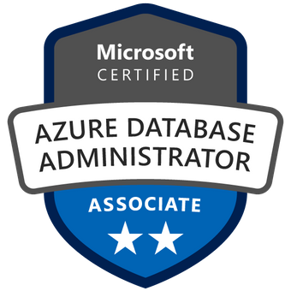
Tim Warner
Based in Nashville, TN, US
Central time zone
MCT, MVP
Twitter: @TechTrainerTim
Web: TechTrainerTim.com

Slide 3
Day 1 of 2 Agenda
Introduction
Microsoft Azure SQL Database Hosting Options
SQL Server to Azure Migration
Configure Database Security

Slide 4
Day 2 of 2 Agenda
Content catch-up
Configure Azure SQL Database High Availability and Disaster Recovery
Monitor and Optimize Azure SQL Server
Integate Azure SQL Server throughout Azure

Slide 5
Course Materials
timw.info/sqlazure

Slide 6
A Different Kind of Training
We'll learn by doing – at least 80 percent demo
Visual, case study approach
10-minute break at midpoint
I’m here to answer your questions – take advantage of this!
Use the Q&A panel instead of group chat, please

Slide 7
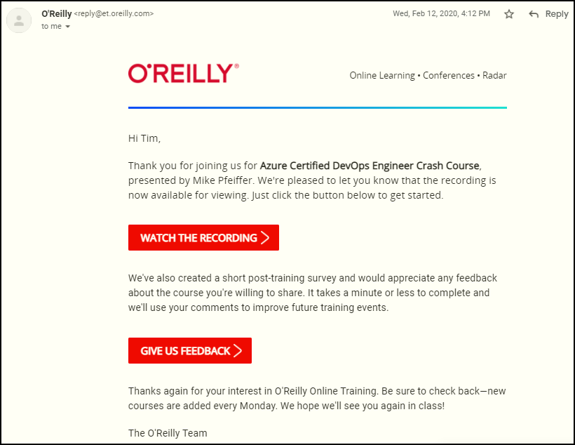
Session Recordings

Slide 8

Session Recordings

Slide 9

Session Recordings

Slide 10


Session Recordings

Slide 11
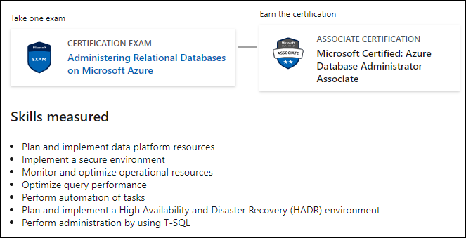
Microsoft Role-Based Certification
DP-300

Slide 12
Thank you!
Course materials: timw.info/sqlazure
Twitter: @TechTrainerTim
Web: TechTrainerTim.com

Slide 13
SQL Server Migration to Azure

Slide 14
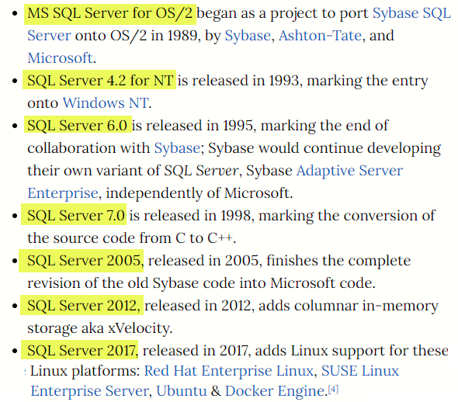
Microsoft SQL Server History
timw.info/tqn

Slide 15
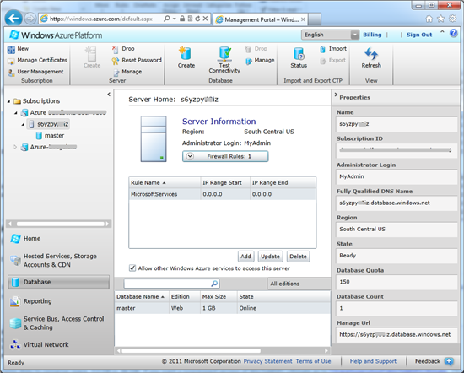
Microsoft SQL Azure (2010)
timw.info/

Slide 16
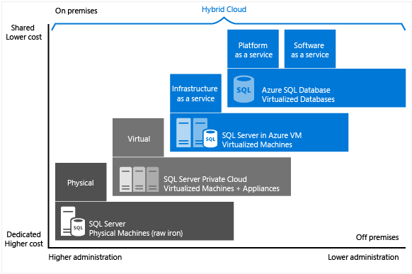
SQL Server Evolution
timw.info/

Slide 17
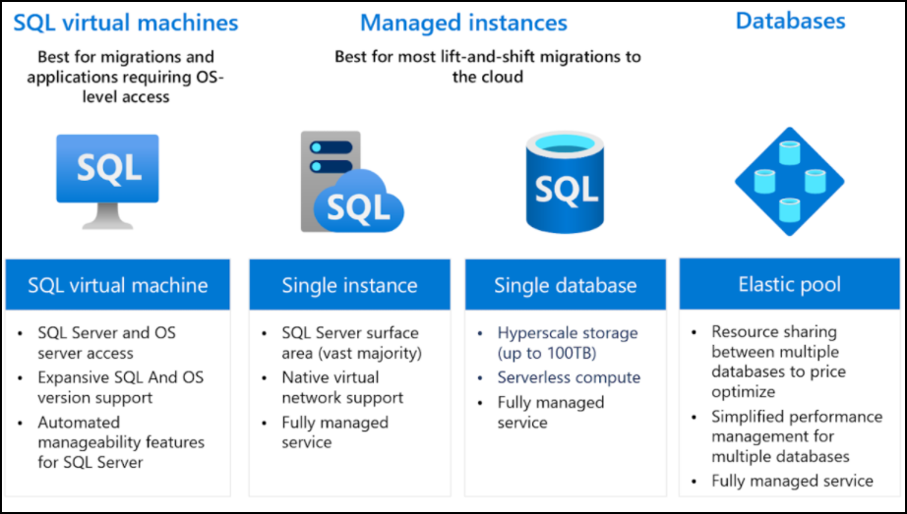
SQL Server Migration Options
timw.info/

Slide 18
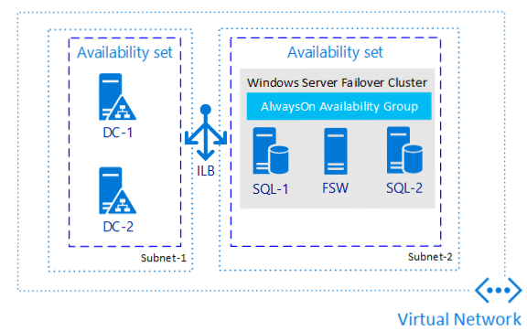
SQL Server in Azure VM
timw.info/bkm

Slide 19
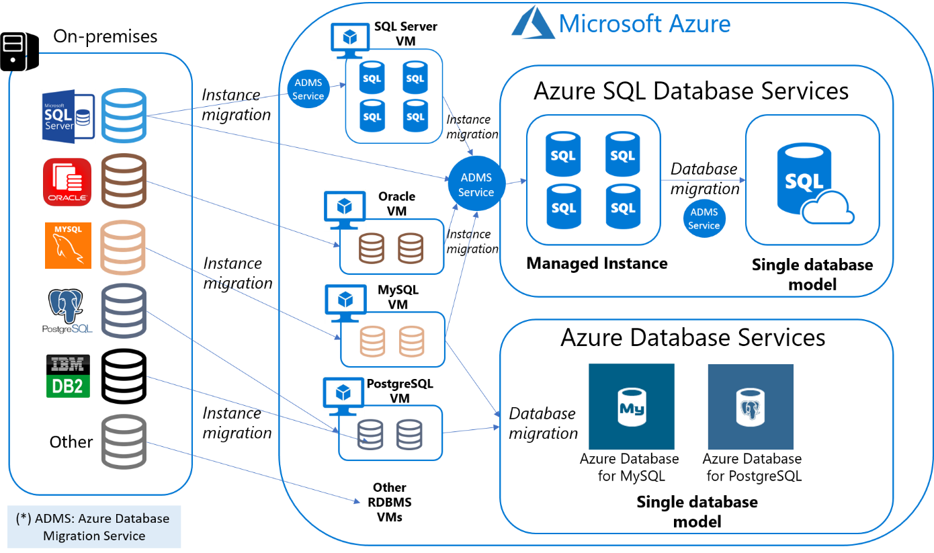
Azure SQL Database
timw.info/73e

Slide 20
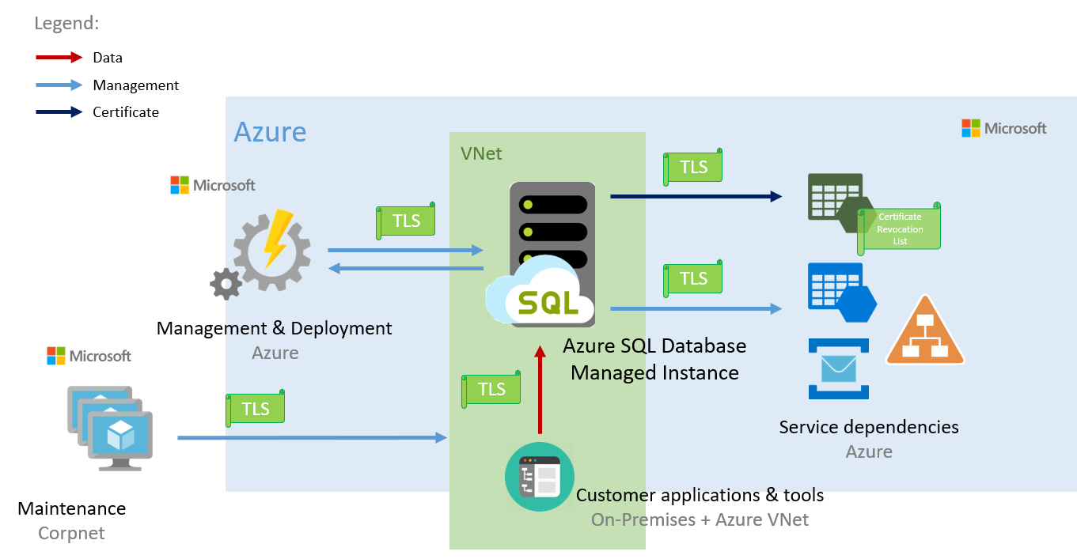
Azure SQL DB Managed Instance
timw.info/x2t

Slide 21
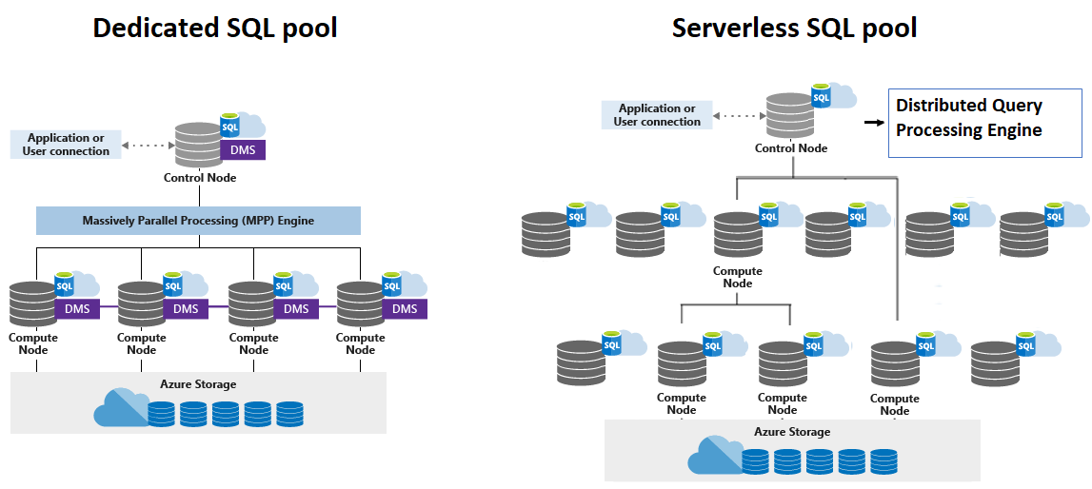
Azure Synapse SQL Pool
timw.info/2je

Slide 22
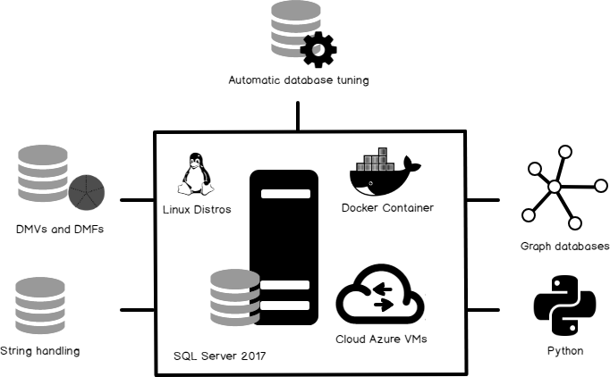
SQL Server on Linux
timw.info/khs

Slide 23
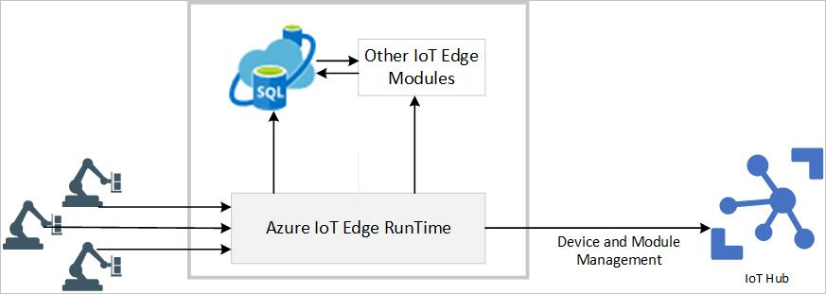
Azure SQL Edge
timw.info/cpa

Slide 24
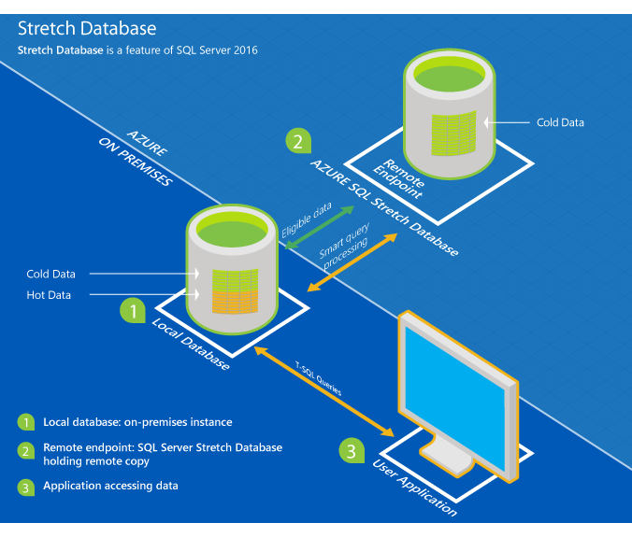
SQL Server Stretch Database
timw.info/ltn

Slide 25
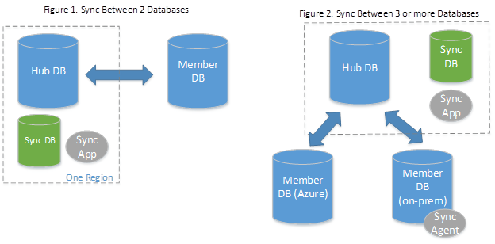
SQL Data Sync
timw.info/9qn

Slide 26

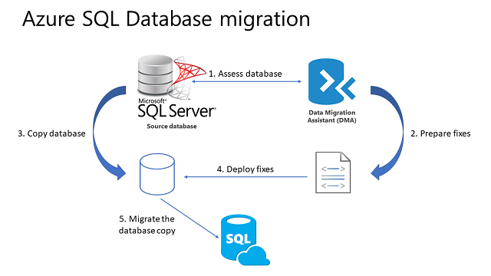
Azure SQL DB Migration Process
timw.info/3u7

Slide 27
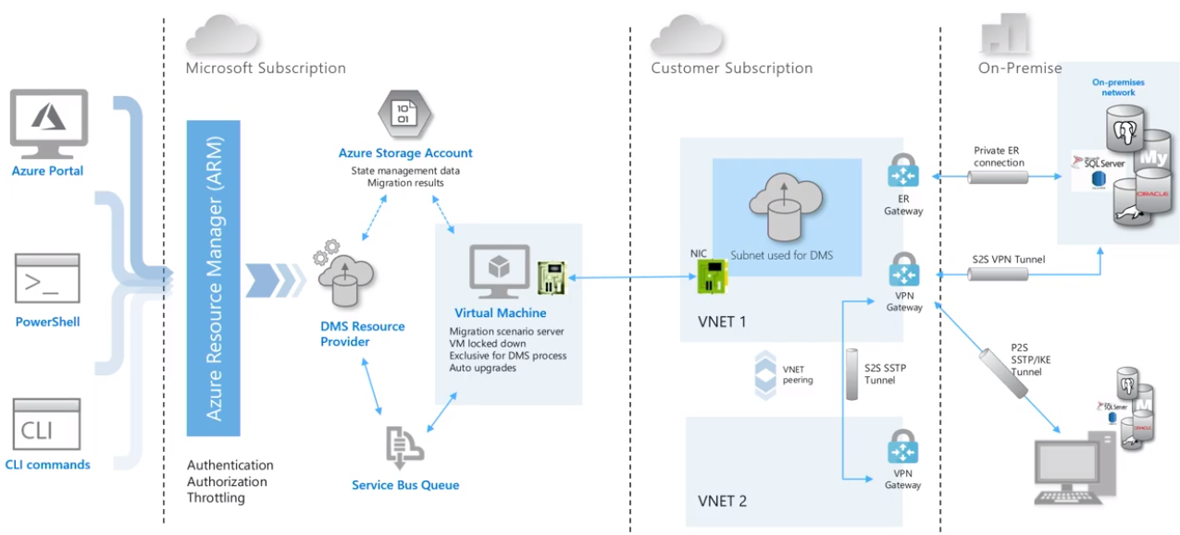
Database Migration Service (DMS)

Slide 28
Azure SQL Database Data Security

Slide 29
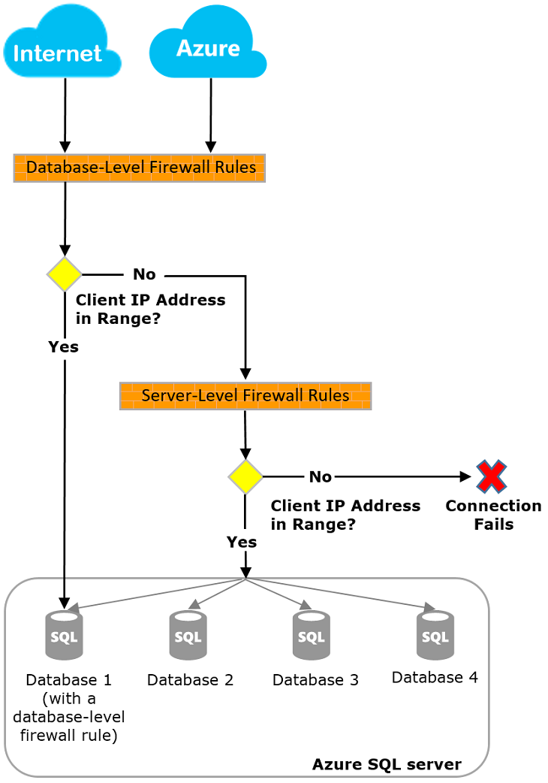
Azure SQL Firewall

Slide 30
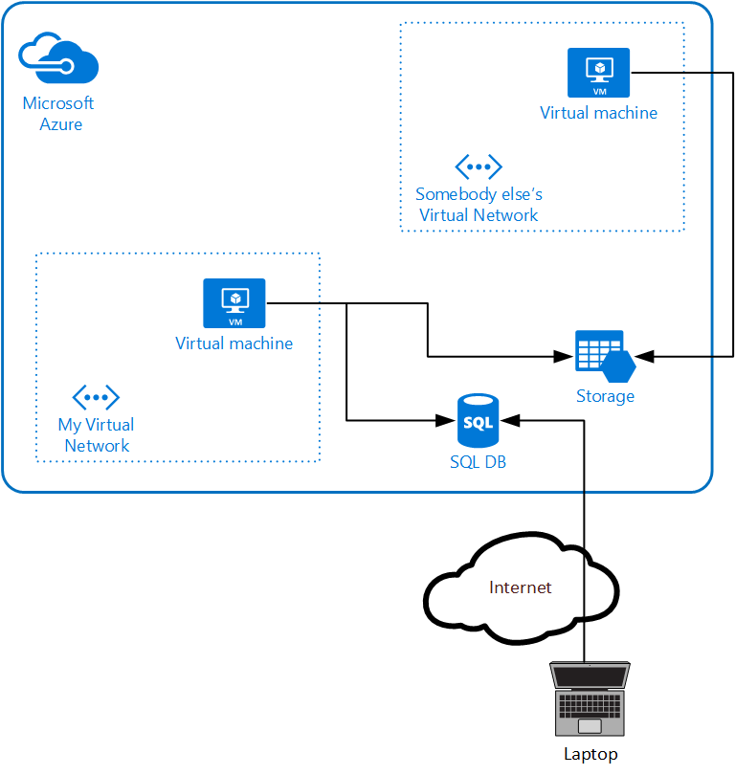
Service Endpoint
timw.info/055

Slide 31
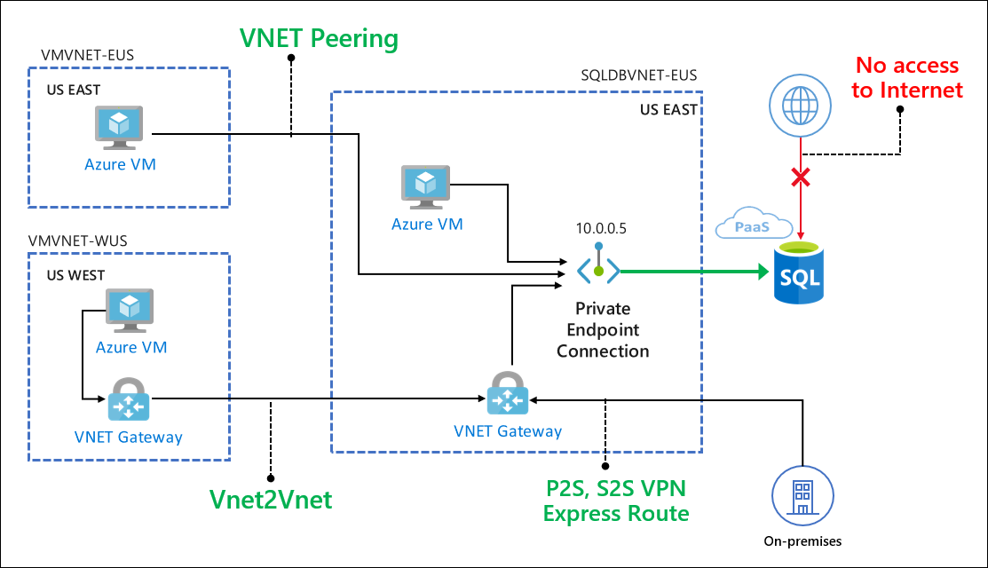
Private Link
timw.info/055

Slide 32
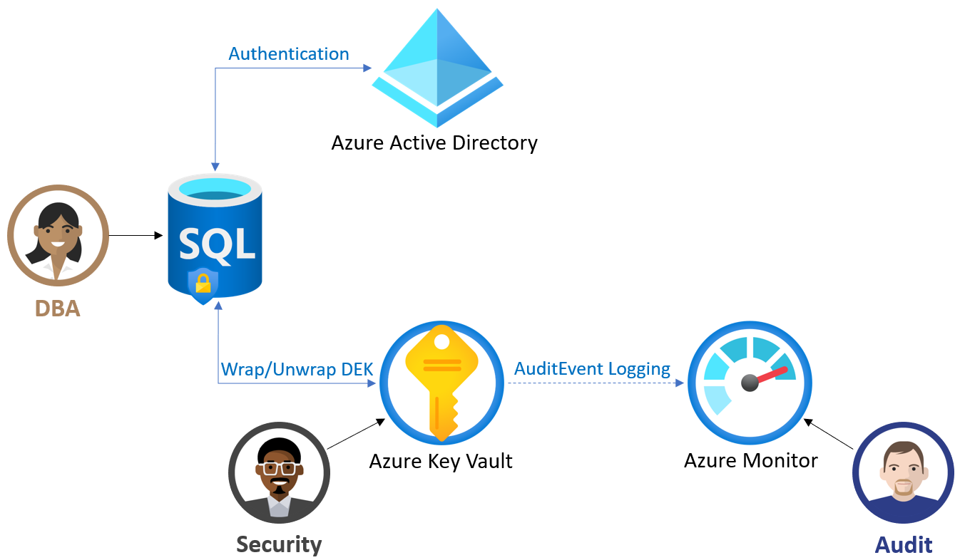
TDE with CMK
timw.info/jaw

Slide 33
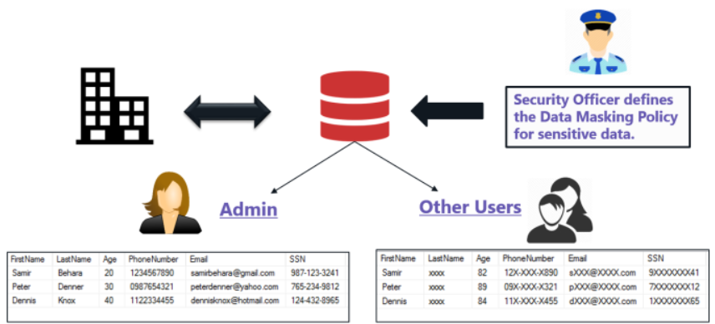
Dynamic Data Masking (DDM)
timw.info/g0d

Slide 34

Always Encrypted
timw.info/qkg

Slide 35
Azure SQL Database High Availability & Disaster Recovery

Slide 36
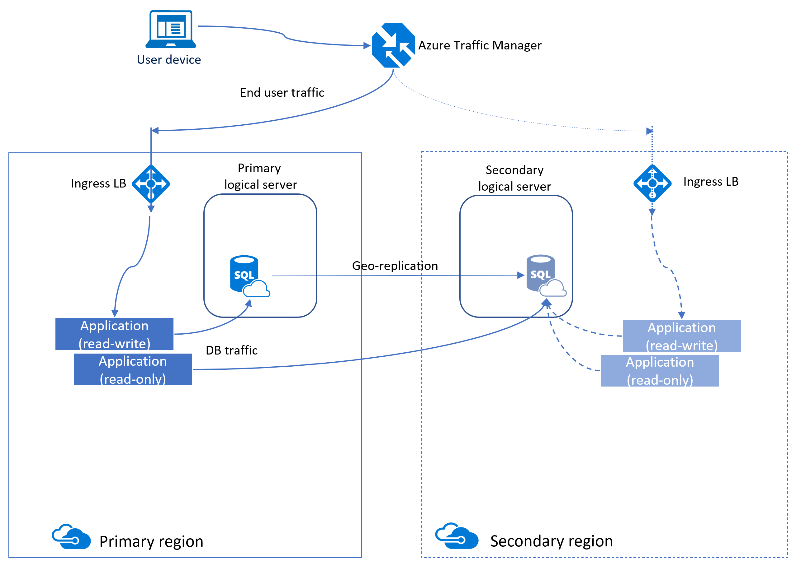
Azure SQL Active Geo-Replication
timw.info/be4

Slide 37
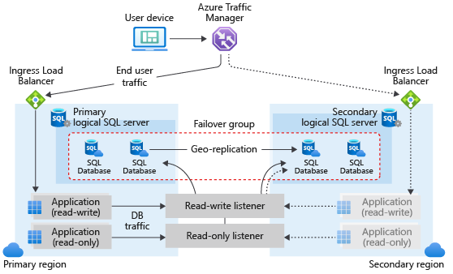
Azure SQL Failover Groups
timw.info/2vl

Slide 38
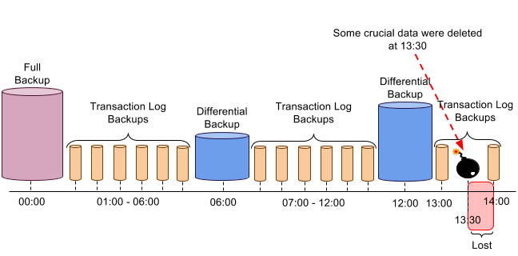
Azure SQL Backup and Restore
timw.info/78a

Slide 39
Azure SQL Database Monitoring and Optimization

Slide 40
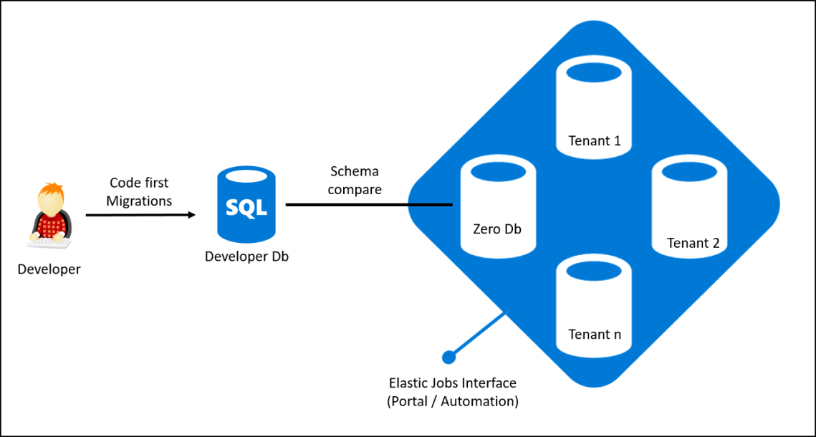
Elastic Pool
timw.info/7y9

Slide 41
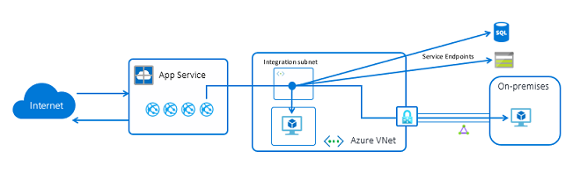
App Service VNet Integration
One way
timw.info/kkn

Slide 42
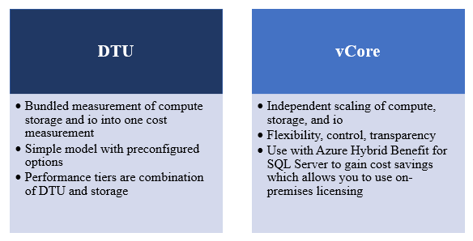
Azure SQL DB Pricing Models

Slide 43
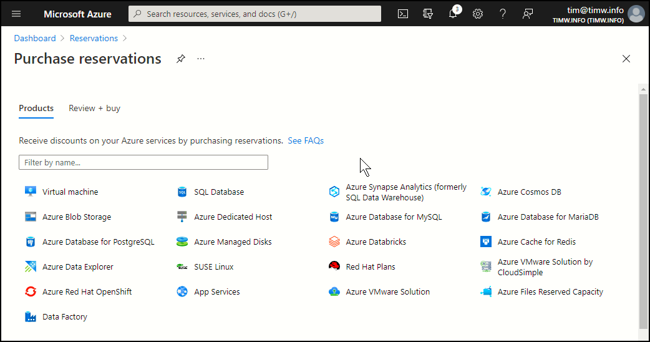
Azure SQL DB Reserved Capacity

Slide 44
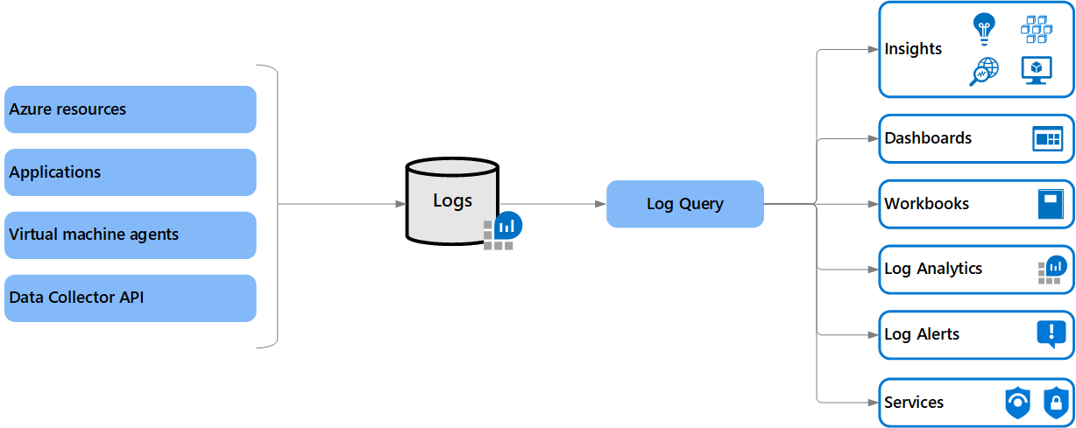
Log Analytics

Slide 45

Azure Monitor

